Slide 1
Energy Storage as a Solution for Increasing Feeder Hosting Capacity: Concepts and Analysis Methods
Gaurav SINGH, Jouni PEPPANEN, Arindam MAITRA
EPRI, USA
Jigar PATEL
Hydro One Limited, Canada

Slide 2
Acknowledgements
The work presented here was funded and supported by Hydro One
Thanks to the distribution team at Hydro One!

Slide 3
Background
There is a growing interest to consider energy storage (ES) as a non-wires alternative (NWA) to increase distribution capacity to serve load or host DER, increase distribution reliability and resiliency, etc.
Integrating ES as an NWA will require additional considerations and analytics within the distribution planning process that can be complex
This paper presents methods to consider ES as an NWA to increase DER hosting capacity

Slide 4
Approach
Identifying ES operational requirements is a key step in considering ES as an NWA. This can be accomplished by performing quasi-static time-series load flow (QSTS) simulations whereby ES control is modeled
However, considering various ES locations and other scenarios can involve performing numerous QSTS simulations, which can become cumbersome
In this paper, ES is controlled to limit the current of monitored feeder elements due to high reverse power flow caused by DER
This paper presents a linear power flow approximation to allow quick screening of multiple ES sites, control logics, and other scenarios:
$$I_{m}\left(t\right)=\frac{dI_{m}}{dS}S(t)+b,$$
where $I_{m}(t)$ is the current of the monitored element, $S\left(t\right)$ is the feeder net load, and $\frac{dI_{m}}{dS}$ and $b$ are the approximation coefficients solved, e.g., with ordinary least squares linear estimation for selected load flow scenarios

Slide 5
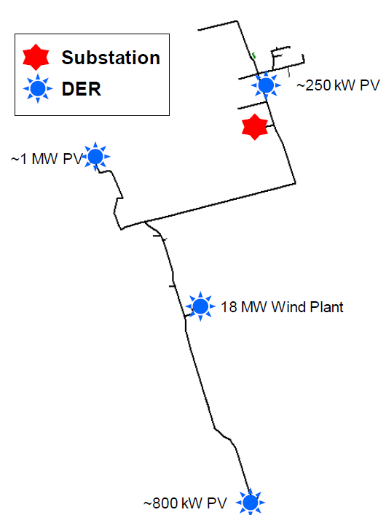
Case Study Distribution Feeder
A 27.6 kV distribution feeder that is supplied by a 115/27.6 kV transmission substation feeding two 27.6/8.32 kV distribution substations and other loads
Peak load ~11.2 MW
An 18 MW wind plant and ~2 MW of distributed PV
Frequent very high reverse power flows towards the feeder head caused by the wind and PV
At high DER penetration, accurate distribution modeling can be challenging

Slide 6
Baseline Hosting Capacity Analysis - Approach
Objectives:
Identify hosting capacity constraints
Get an indication of the storage operational requirements
Obtain an idea of possible/required storage locations
Performed with EPRI’s DRIVE tool
Careful selection of hosting capacity scenarios important at high penetration of existing DER

Slide 7
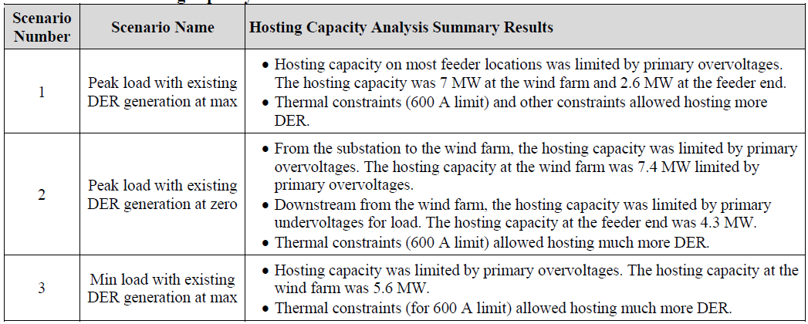
Baseline Hosting Capacity Analysis - Results
To illustrate the proposed methods, a sensitivity hosting capacity analysis was performed assuming a 400 A line ampacity
This resulted in the hosting capacity to be mainly limited by thermal overloads

Slide 8
Increasing Feeder Hosting capacity with ES
ES is unlikely economically attractive for increasing DER hosting capacity limited by voltage constraints (smart inverter functions and conventional regulation equipment likely more economic)
Increasing DER hosting capacity limited by thermal overloads is likely a more economically attractive ES application
The linear approximation allows to quickly screen many scenarios
Figure illustrates the ES MW and MWh requirements with respect to the current clipping limit. Power (energy) requirements grow linearly (exponentially) with the limit.
A 350 A limit would require a 2 MW ES
A 350 A limit would require a 2 MW ES

Slide 9
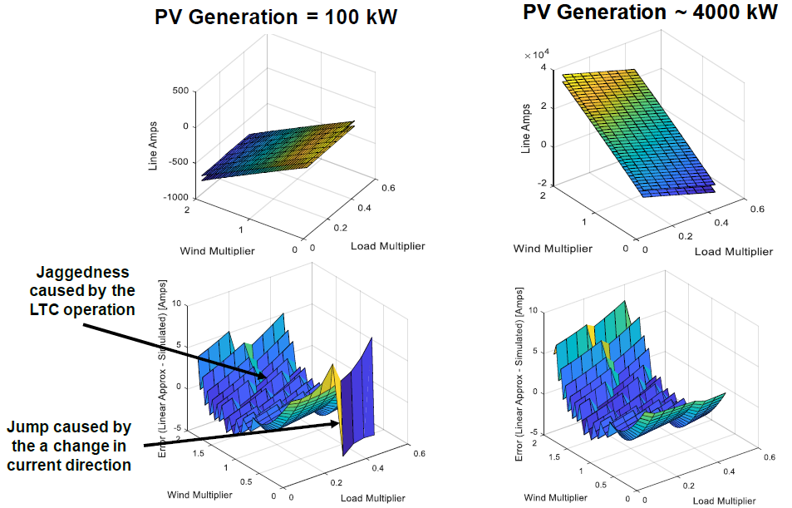
Accuracy of the Linear Approximation
At high DER penetration, the linear approximation depends both on the feeder load and DER generation (more complex)
Linear approximation remains sufficiently accurate for screening purposes (max current error ~10 A)

Slide 10
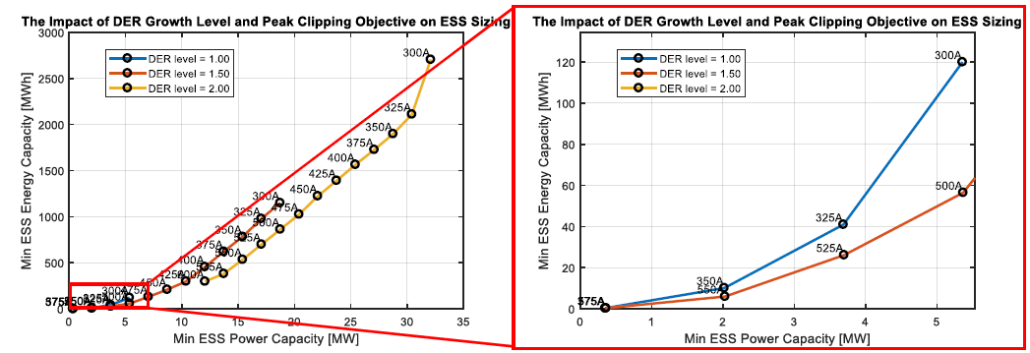
Accuracy of the Linear Approximation
Figure below illustrates the advantage of the linear approximation by showing the ES MW and MWh requirements with respect to the current clipping limit and DER growth (%/100 of the existing DER)
Leveraging the linear approximation, this plot requires running only a handful of powerflows, which takes just seconds to run
Creating this plot with QSTS simulations would take hours to perform

Slide 11
Key Take Away
Selecting hosting capacity scenarios with a high penetration of existing DER can be challenging
This paper shows an approach to leverage the EPRI DRIVE© tool to analyze the feeder hosting capacity, the factors limiting the hosting capacity, and to identify storage operational requirements to increase hosting capacity
It is important to carefully consider the hosting capacity limits and the most cost-effective options to mitigate the constraints
An approach to identify energy storage power and energy capacity requirements leveraging linear approximations was shown.
The linearization must also be performed with respect to the load and DER on the feeder
The linearization becomes more complex when the feeder has multiple types of DER that are considered separately
While the accuracy of the linearized approach depends on several factors, the linearization can be an effective tool to evaluate many storage scenarios

